Slide 1

VRGen: Deep Learning Based VR Property Walkthroughs Using 2D Plans (SDG’s: 4, 9, 11, 12)
Yash Penkar (22106118)
Prarthana Patil (22106035)
Rutuja Pawar (22106043)
Dhruv Sawant (22106015)
Under the Guidance of
Prof. Vijesh Nair

Slide 2
Outline
Introduction
Literature Survey of the existing systems
Limitations of the existing systems
Problem statement and Objective
Proposed System
Experimental Setup(Details about input/ dataset, Performance evaluation parameters, Software and hardware setup)
Implementation(Screenshots of all modules)
Conclusion and future work
References
Research Paper Publication / Patent/ Copyright status

Slide 3
Introduction
Visualization of 3D structures from 2D floorplans is essential in architecture and real estate.
2D floorplans convey spatial information but lack immersive perspective for stakeholders.
Developers and architects rely on 3D modeling tools (AutoCAD, SketchUp, Blender) for design communication.
Conventional 3D modeling is manual, time-consuming, costly, and requires skilled professionals.
Manual dependency slows workflows and is unsuitable when multiple layouts must be visualized quickly.
Advances in AI and computer vision enable automated visual reconstruction.
GANs, especially Pix2Pix (U-Net generator + PatchGAN discriminator), are effective for image-to-image translation.
Proposed pipeline: 2D floorplan → heightmap → 3D mesh via voxelization (Trimesh).
System directly exports GLB models, removing dependency on CAD/Blender for post-processing.
Browser-ready and VR-compatible outputs enable lightweight interactive visualization.

Slide 4
Motivation:
Many buyers and clients find it difficult to visualize property layouts from 2D drawings.
Growing demand for virtual property tours, especially in remote buying scenarios.
Advances in deep learning for image-to-image translation make automated floorplan-to-3D conversion feasible.
Ability to generate 3D meshes automatically (heightmap_to_mesh) without manual CAD modeling strongly motivated this project.
Objectives:
To design a Conditional GAN architecture.
To build a floorplan-to-mesh pipeline.
To ensure compatibility with modern platforms.
To support flexible inference modes.
To validate with limited data and ensure scalability.

Slide 5
Literature Survey of the Existing System
Year | Title | Domain | Algorithm | Dataset | Gap
2024 | Plan–MORPH: Conversion of 2D Floorplans to 3D Models | Image Processing / 3D Modelling | Python Flask web app using OpenCV (Canny edge detection, contour tracing) + Trimesh for 3D STL generation | User-uploaded 2D floorplans (.jpg) | Edge detection errors in noisy/complex inputs; lacks ML automation; scalability and accuracy still limited
2022 | Generating 3D Architectured Nature-Inspired Materials Using Diffusion Models | Materials Science / AI for Design | Stable Diffusion + text-to-image prompts → voxelization → Trimesh + coarse-grained particle simulation | Pre-trained Stable Diffusion (sd-v1-4), no specific domain dataset (language–image pairs) | Current diffusion models don’t natively produce 3D; interpolation/voxel stacking is workaround; early-stage method
2021 | 3DPlanNet: Generating 3D Models from 2D Floor Plan Images Using Ensemble Methods | Computer Vision / Architecture | Ensemble approach combining deep learning (logistic regression, CNN, TensorFlow detection) + rule-based heuristics | 30 floor plan images (small dataset) | Needs large-scale automated dataset creation; diagonal walls and complex structures not well supported
2021 | Plan2Scene: Converting Floorplans to 3D Scenes | Computer Vision, 3D Scene Reconstruction, Deep Learning | Encoder–Decoder Network for Texture Synthesis + Graph Neural Network (GNN) for Texture Propagation | Rent3D++, Stationary Textures, and Substance Mapped Textures datasets. | Existing 3D methods need dense images or camera poses; this paper uses floorplans and sparse photos with a GNN to generate textured 3D interiors.
2018 | Developing and Evaluating a VR-Based Navigation System for Pre-Sale Housing Sales | Virtual Reality / Real Estate | VR system using SketchUp, Lumion, Enscape, GearVR; evaluated with TAM (Technology Acceptance Model) | Case study: Pre-sale housing project in Taiwan, 30 test users | Ease of use is still low; small sample size; limited generalizability to broader real estate market

Slide 6
Limitations of Existing Systems
Manual dependency on CAD tools or software like Blender makes the process slow, expensive, and designer-dependent.
Many past approaches used basic Convolutional Neural Networks (CNNs) or combined multiple weaker models (Ensemble Methods) to solve different parts of the problem (e.g., one model for walls, another for doors).
Older or simpler methods (like Plan-MORPH) rely heavily on classic computer vision algorithms like Canny Edge Detection or contour tracing on the input image.
Some deep learning models might output raw voxels or an imperfect mesh that is not structurally sound for use in game engines or professional software.
Many systems stop at intermediate outputs like heightmaps or voxel grids, requiring external tools for mesh generation and visualization.

Slide 7
Problem Statement
Real estate developers struggle to market properties before sample flats are built, as traditional tools like brochures and 2D floor plans fail to give buyers a true sense of the space. This limits early sales and customer engagement. There is a need for a solution that transforms 2D floor plans into realistic 3D models viewable in Virtual Reality (VR), enabling customers to explore and experience the property before construction is complete.
Elaboration of Problem Statement:
Limitations of Traditional Tools: Marketing materials such as static images, drawings, or brochures are not interactive, fail to convey depth, and do not provide an immersive experience of space.
Impact on Sales and Engagement: Because customers cannot truly visualize the property, they hesitate to make early purchase decisions. This limits the ability of developers to secure bookings before construction is complete.
High Cost of Current Alternatives: Existing 3D modeling or VR solutions require skilled designers, manual CAD work, and expensive tools. These methods are not scalable when developers need to showcase multiple flats, towers, or entire projects.

Slide 8
Need for Automation: Developers require an automated system that can quickly convert 2D architectural floor plans into interactive 3D models without heavy manual intervention.
VR Integration: The solution should provide VR-ready walkthroughs, allowing customers to explore and experience the property virtually as if they were physically present.
Business Value: Such a solution would enhance customer trust, improve engagement, accelerate early sales, and reduce reliance on costly sample flats.
Difficulty in Visualization: Buyers often struggle to imagine the real look and feel of a property by only seeing 2D floor plans or printed brochures. This creates a gap between design intent and customer understanding.

Slide 9
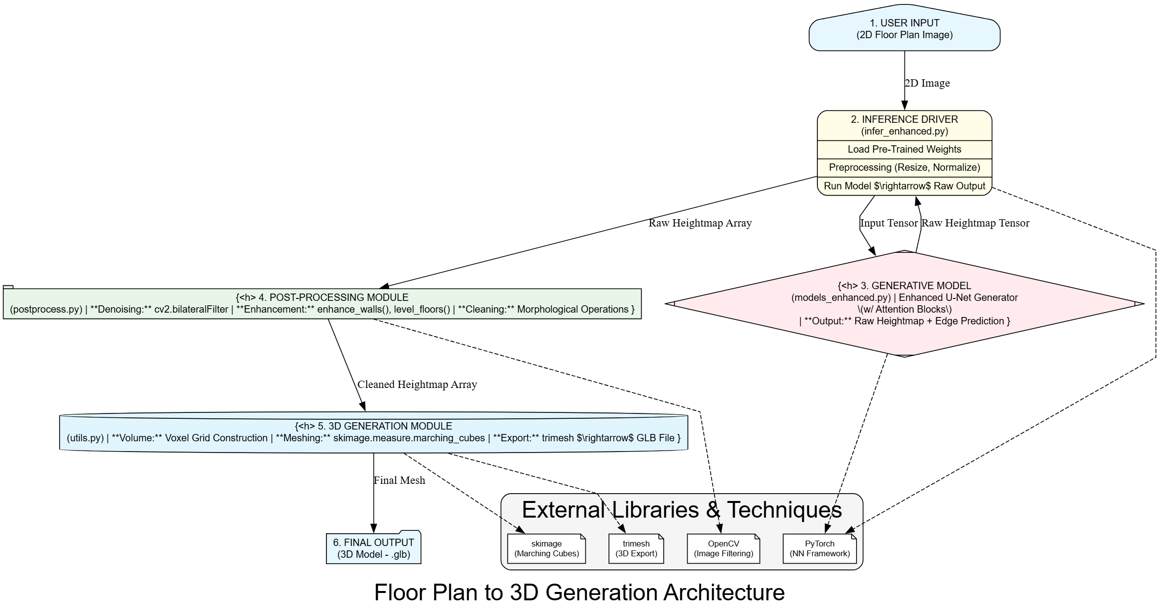
System Design
Fig.1. Architecture Diagram for VRGen: Deep Learning-Based VR Property Walkthroughs Using 2D Plans

Slide 10
System Design
1. Input Floorplan Images
The system begins with floorplan images in .png or .jpg format stored in data/floorplans/.
2. Preprocessing & Synthetic Target Generation (src/dataset.py)
Input images are resized, thresholded, and distance-transformed.
The output is a synthetic heightmap (.png), which serves as the target for training.
3. Generator (U-Net, src/models.py)
The Generator model takes a 256×256 RGB floorplan as input.
It predicts a corresponding 256×256 heightmap, representing elevation data.
4. Discriminator (PatchGAN, src/models.py)
During training, the Discriminator evaluates pairs of (floorplan + heightmap) to determine whether the generated heightmap is real or fake.
It provides feedback to improve the Generator.

Slide 11
5. Training Loop (src/train.py)
Uses GAN + L1 losses to optimize the model.
Model weights are saved as checkpoints (checkpoints/netG_*.pth).
6. Inference (src/infer.py / batch_infer.py)
Loads the trained model (netG_final.pth) to generate 3D outputs (.glb files).
7. Heightmap → Mesh Conversion (src/utils.py)
Converts the predicted heightmap into a 3D mesh using Trimesh voxelization.
Outputs are .glb and .ply files.
8. Export & Visualization
The 3D meshes are exported to outputs/meshes/*.glb.
Finally, they can be viewed in an interactive browser viewer (src/view_mesh.py) using Plotly, producing view.html.

Slide 12
Tools and Technologies
1. Deep Learning (GAN – Pix2Pix Framework)
Uses U-Net Generator for translating 2D floor plans → heightmaps.
Uses PatchGAN Discriminator to enforce local realism.
Training with Adversarial Loss (MSE) + L1 Loss ensures both realism and structural accuracy.
Customization: Added dropout regularization, adjustable λ (L1 weight), and proposed InstanceNorm & spectral normalization for better stability.
2. Image Processing Techniques
Otsu Thresholding: Automatically separates walls from background in 2D plans.
Distance Transform: Converts wall thickness into continuous heightmaps.
Morphological Operations: Remove noise and connect broken wall lines.
Customization: Added random flips, rotations, blur to augment dataset and proposed stronger augmentations (color jitter, affine transforms).

Slide 13
3. Mesh Generation (Trimesh + Voxelization)
Converts predicted heightmaps into 3D voxel grids.
Uses trimesh.voxel.VoxelGrid to export .glb/.ply meshes.
Customization: Proposed Marching Cubes algorithm and Laplacian smoothing for smoother meshes, and semantic-driven extrusion for walls/rooms.
4. Visualization & VR
Current: Plotly Mesh3d for interactive HTML viewers.
Proposed: Three.js / A-Frame with WebXR for immersive VR walkthroughs.
Customization: Add texture mapping, mesh simplification, and compression for faster VR rendering.

Slide 14
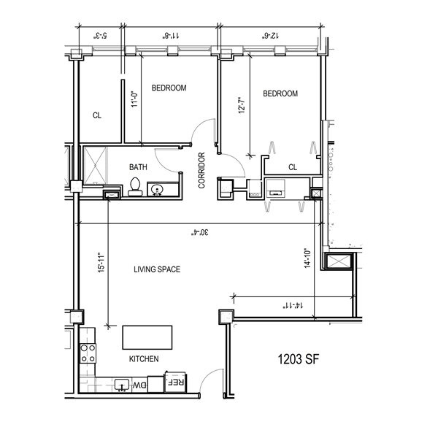
Implementation
Fig.2. Floor Plan

Slide 15
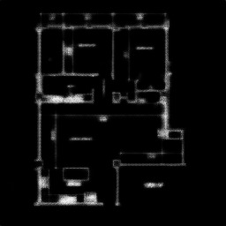
IMPLEMENTATION
Fig.3. Mesh

Slide 16
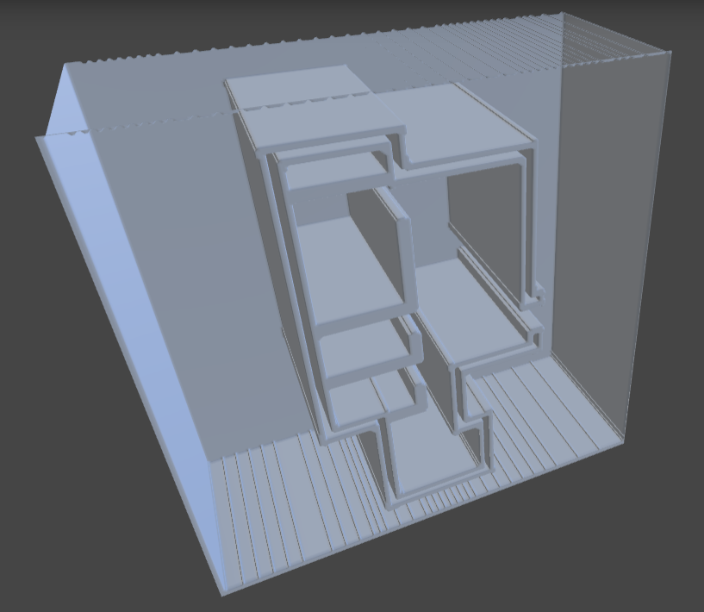
IMPLEMENTATION
Fig.4. 3D Model (Glb Format)

Slide 17
Sustainable Development Goals (SDGs)
1. SDG 9 – Industry, Innovation, and Infrastructure: Promotes AI-driven innovation in architecture and real estate visualization, enhancing design efficiency and accuracy.
2. SDG 11 – Sustainable Cities and Communities: Enables smart urban planning through VR simulations, reducing waste and improving sustainable housing design.
3. SDG 4 – Quality Education: Serves as an interactive VR learning tool for students to understand spatial design and AI-driven modeling.
4. SDG 12 – Responsible Consumption and Production:Encourages virtual prototyping to minimize material use and promote resource-efficient construction planning.

Slide 18
References
[1] Reddy, V. K. G. N., Prajwal, V., Reddy, V. G. N., Srushti, G. S., & Nirmala, S. (2024). Plan–MORPH: Conversion of 2D Floorplans to 3D Models. International Journal of Enhanced Research in Science, Technology & Engineering, 13(12), 37–42.
[2] Buehler, M. J. (2022). Generating 3D architectured nature-inspired materials and granular media using diffusion models based on language cues. Oxford Open Materials Science, 2(1), itac010.
[3] Park, S., & Kim, H. (2021). 3DPlanNet: Generating 3D Models from 2D Floor Plan Images Using Ensemble Methods. Electronics, 10(22), 2729.
[4] Madhawa Vidanapathirana, Qirui Wu, Yasutaka Furukawa, Angel X., Chang Manolis Savva, Simon Fraser University (2021). Plan2Scene: Converting Floorplans to 3D Scenes. IEEE/CVF Conference on Computer Vision and Pattern Recognition (CVPR).
[5] Juan, Y.-K., Chen, H.-H., & Chi, H.-Y. (2018). Developing and Evaluating a Virtual Reality-Based Navigation System for Pre-Sale Housing Sales. Applied Sciences, 8(6), 952.

Slide 19
THANK YOU

